Slide 1
Blood Donor Finder
(MERN Stack Implementation)
Hackathon Project
CSE (AI & ML) - E
K.SAI SIDHARTHA 25MVCSMR0402
A.SATHWIK RAO 25MVCSMR0368
M.RAHUL KUMMAR 25MVCSMR0418
A.JESHWANTH REDDY 25MVCSMR0365
CH.SRI CHARAN 25MVCSMR0385

Slide 2


The Problem
Critical Time Loss
Delays in finding matching blood during emergencies.
Fragmented Systems
Lack of real-time, centralized donor databases.

Slide 3



PROPOSED SOLUTION
A web platform to connect donors and recipients instantly.
Core Objectives:
Data Management
Connectivity
Experience
Implement CRUD operations.
Build robust REST APIs.
Create a user-friendly UI.

Slide 4
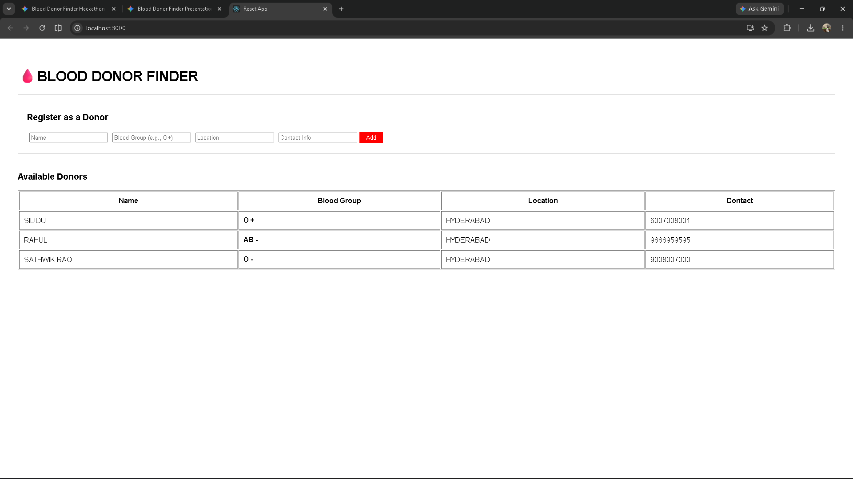
System Features
1
Donor Registration Form
(Name, Blood Group, Location, Contact)
2
Real-time Donor Dashboard
3
REST API Integration

Slide 5








Technology Stack
The MERN Architecture
MongoDB
Express.js
React.js
Node.js
Database
Backend Framework
Frontend Interface
Runtime Environment

Slide 6


Conclusion & Future Scope
Current Setup
Future Scope
Working prototype fully deployed for viewing and securely adding donors.
•
Add JWT Authentication
•
SMS Notifications
•
Live Map Integration

